Slide 1

Prediction of hotel booking cancellation probability, based on the booking details
Dana Benyamin Hassid
Katya Arnold
Egor Genov
Ran Amran
Binyamin Rosenstein

Slide 2

Motivation
CORRECT MANAGEMENT
INFORMED DECISION MAKING
BOOKING DETAILS
Detecting the key features about the reservations.
Predicting the correct number of visitors will allow for more efficient management of workers, food etc.
Taking in consideration particular booking details will allow for predicting the outcome of the booking
Your logo
1
Notes:
קטיה

Slide 3
DATA ANALYSIS
2
Visualising the data set (EDA)
Cleaning the data set
Analysing the data set
Describing the data set: shape, columns, values, distribution, null values
Cleaning: NaN values, non-logical data (e.g. total number of nights\guests is null)
Analysis: observing correlations between parameters, dropping useless columns, scaling the data, turning categorical variables to dummy
Notes:
קטיה

Slide 4
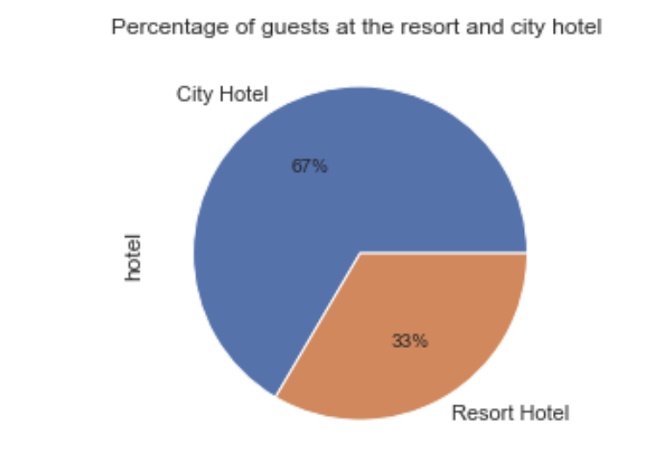
EDA
Visualizing of the columns data:
In order to analyze the data we created graph visualization of part of the columns:
Percentage distribution of observations by hotel:
Notes:
רן

Slide 5
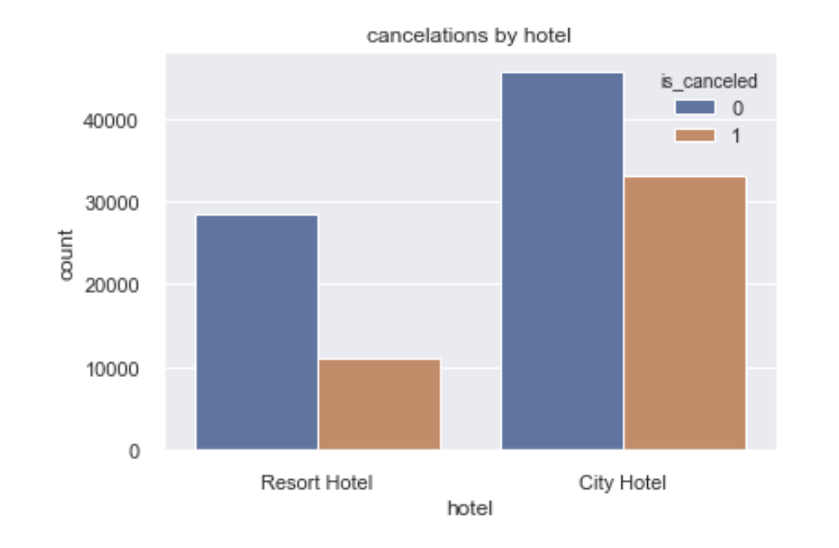
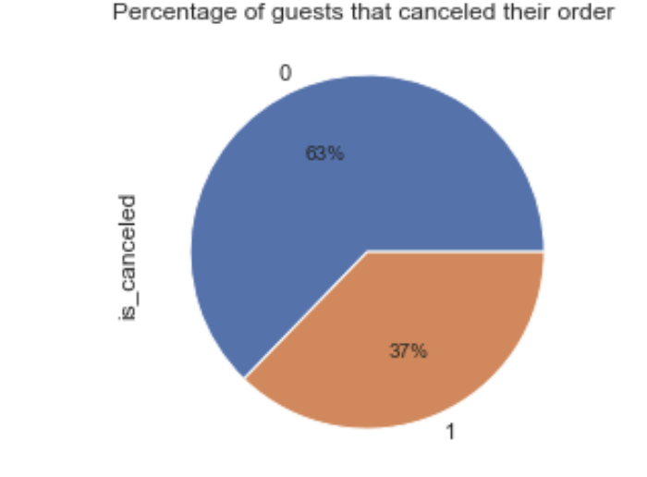
Percentage of guests that canceled their order:
We also examined the number of reservations that has been canceled for each one of the hotels:
Notes:
רן

Slide 6
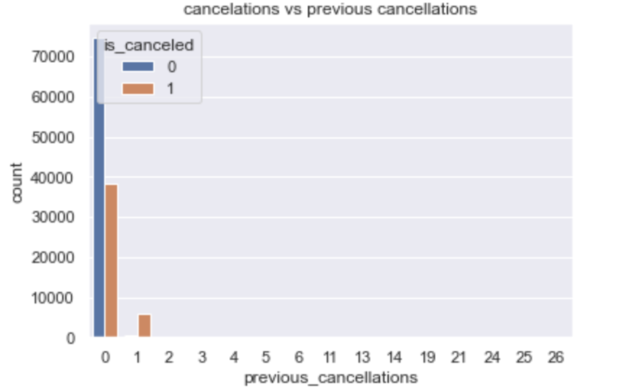
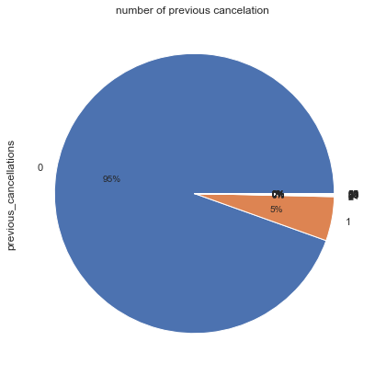
ANALYSING THE DATASET
e
Low number of observations, but the correlation is high
5
Notes:
רן

Slide 7
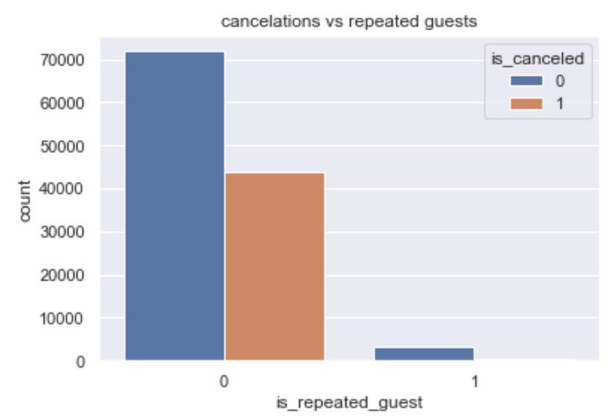
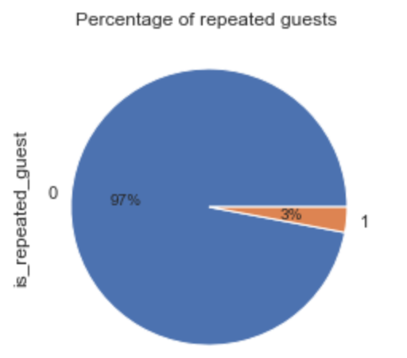
ANALYSING THE DATASET
e
Low number of observations, but the correlation is high
5
Notes:
רן

Slide 8
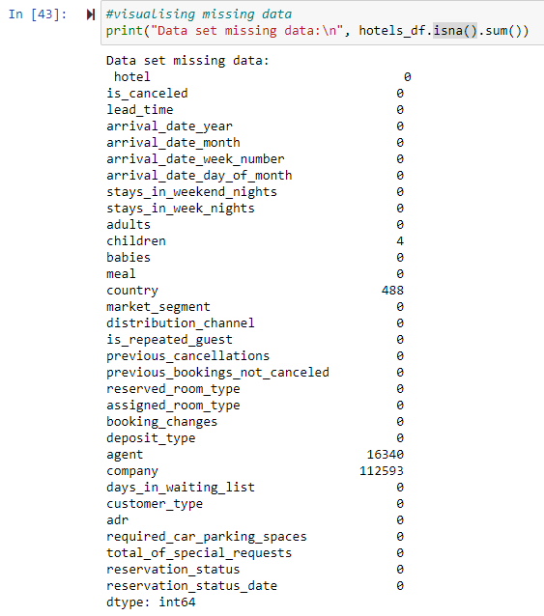
Missing values
Notes:
רן

Slide 9
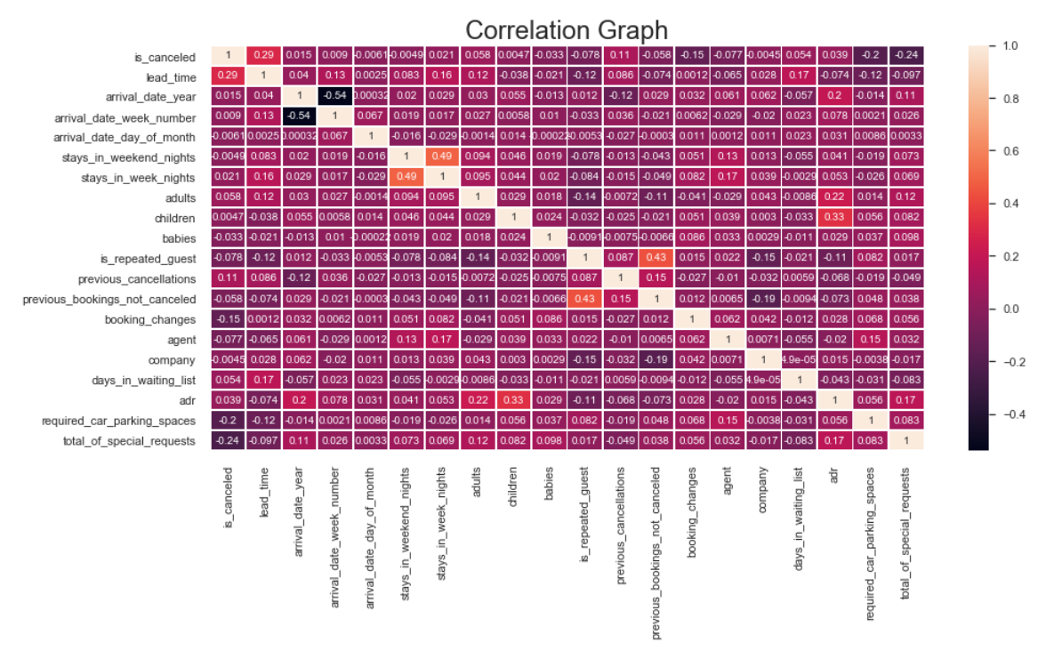
4
Notes:
רן

Slide 10
We can see that the highest correlated attributes are:
lead_time
previous_cancelations
booking_changes
required_car_parking_spaces
total_of_special_requests
Notes:
רן

Slide 11
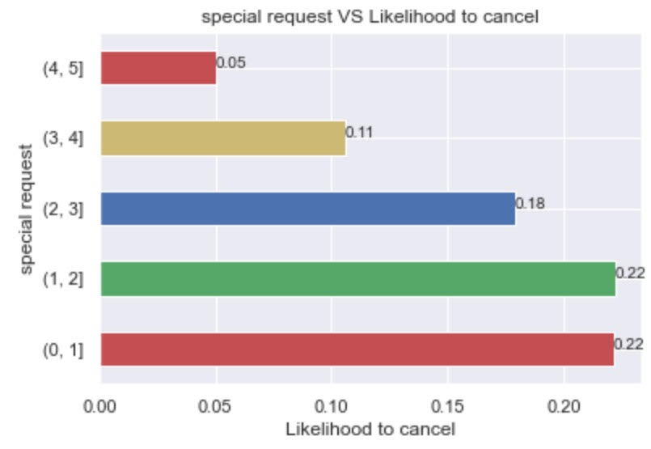
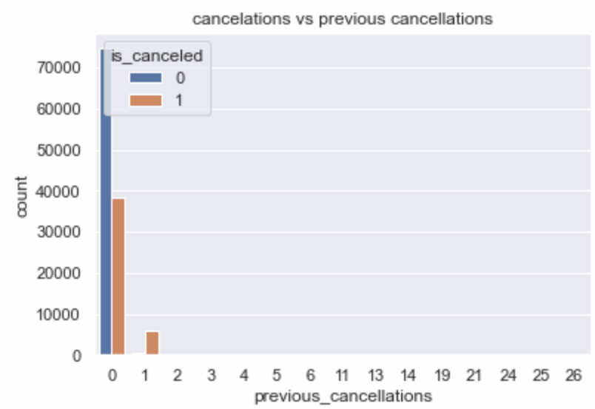
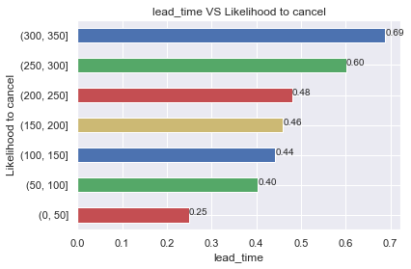
ANALYSING THE DATASET
Total number of special requests
Previous cancellations history
Lead Time versus likelihood to cancel
Тhe number of special requests raises the chances of cancelation decrease.
The rate of cancellation for customers who have cancelled previously is significantly higher
The chance of cancellation is higher the longer in advance a room is booked
6
Notes:
רן

Slide 12
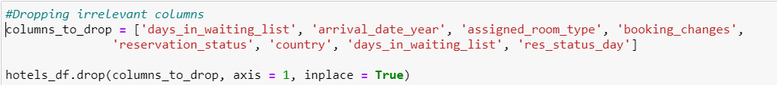
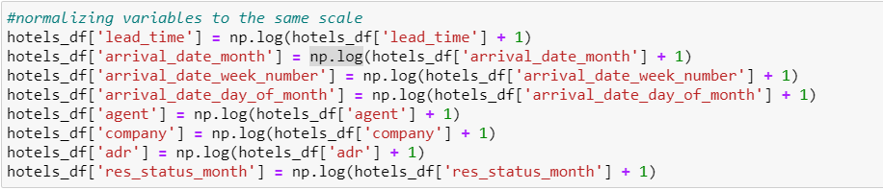
PREPARING THE DATASET FOR MODELLING
Checking for NaN values,
Dropping irrelevant columns
Introducing dummy variables
Scaling the data
Notes:
בני

Slide 13



MODEL BUILDING
Logistic regression
K-nearest neighbours
Decision tree classifier
Random forest classifier
In order to predict the outcome of the booking we decided to employ a few ML models and then compare between them for the best results. Since our problem is a classification problem, we will stick to classification models.
Evaluation: Precision, recall, f1, ROC/AUC
Notes:
בני

Slide 14
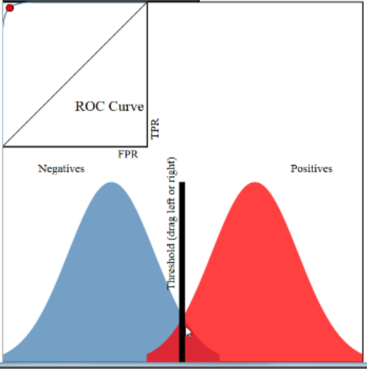
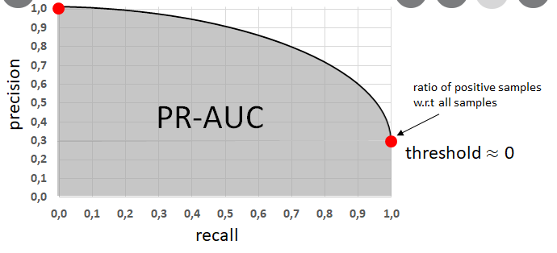
MODEL EVALUATION
Accuracy score
= correct predictions / total number of data points
F1 score
= 2 * (precision * recall) / (precision + recall)
ROC/AUC score
ROC = specificity/sensitivity
AUC = separability
7
Notes:
בני

Slide 15

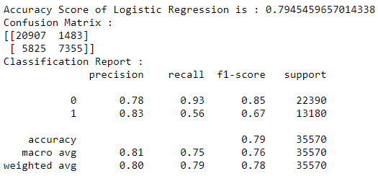
LOGISTIC REGRESSION
Logistic regression is a statistical model that allows us to estimate the probability of certain events. It is based on the logistic function to model a binary dependent variable. In this project we model the probability of a dependent variable (“is_cancelled”) to equal 1.
Your logo
10
Notes:
איגור

Slide 16
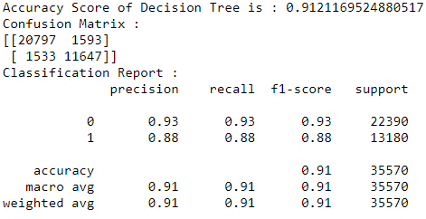
Decision tree classifier
Decision three is a predictive modelling approach that uses a decision tree to go from observations about an item (represented in the branches) to conclusions about the item's target value (represented in the leaves). In the current project we used sklearn.tree.DecisionTreeClassifier() function with its default parameters.
10
Notes:
איגור

Slide 17
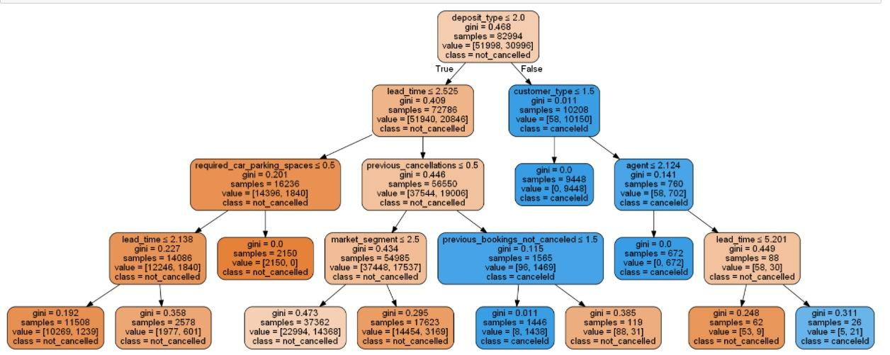
Notes:
איגור

Slide 18
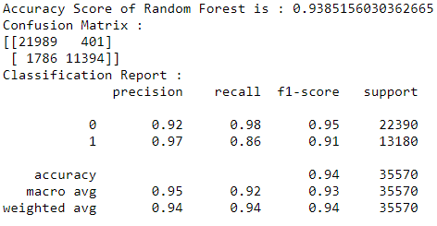
RANDOM FOREST
Random forest classifier is an ensemble learning method for classification, regression and other tasks that operates by constructing a multitude of decision trees at training time. For classification tasks, the output of the random forest is the class selected by most trees.
In the current project we used sklearn.tree.DecisionTreeClassifier() function with its default parameters. In the current project we used sklearn.ensemble.RandomForestClassifier() function with its default parameters.
10
Notes:
איגור/קטיה

Slide 19
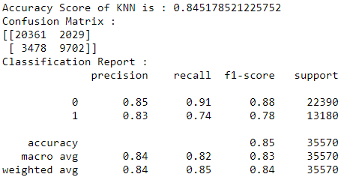
KNN
The k-nearest neighbors algorithm is a non-parametric classification method that uses k closest points to perform classification. As the output the model is classifying the test set to one of the known classes of the training set. An object is classified by a plurality vote of its neighbors, with the object being assigned to the class most common among its k nearest neighbors (k is a positive integer, typically small). If k = 1, then the object is simply assigned to the class of that single nearest neighbor. In our model we used sklearn.neighbors.KNeighborsClassifier() function with its default settings with n_neighbors=5.
10
Notes:
איגור

Slide 20
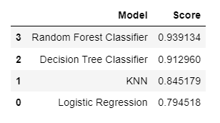
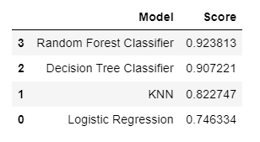
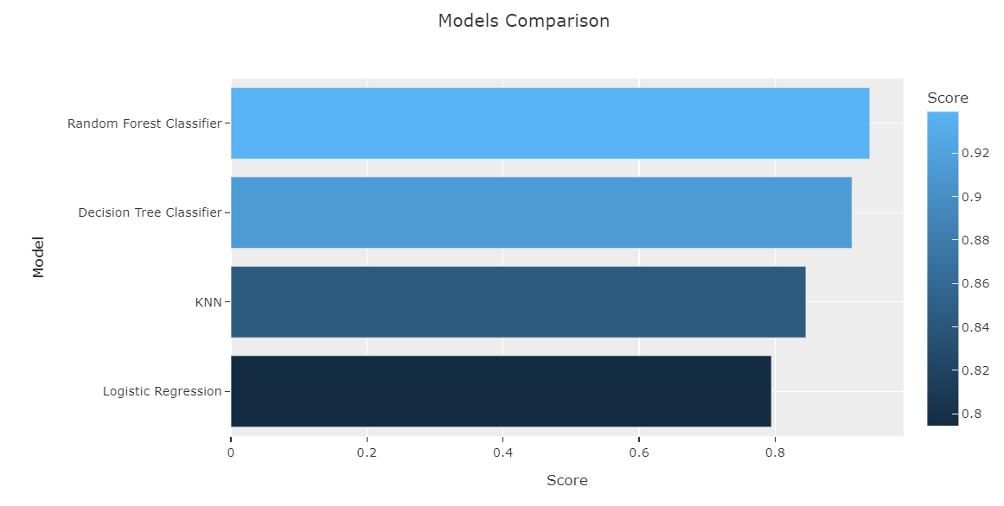
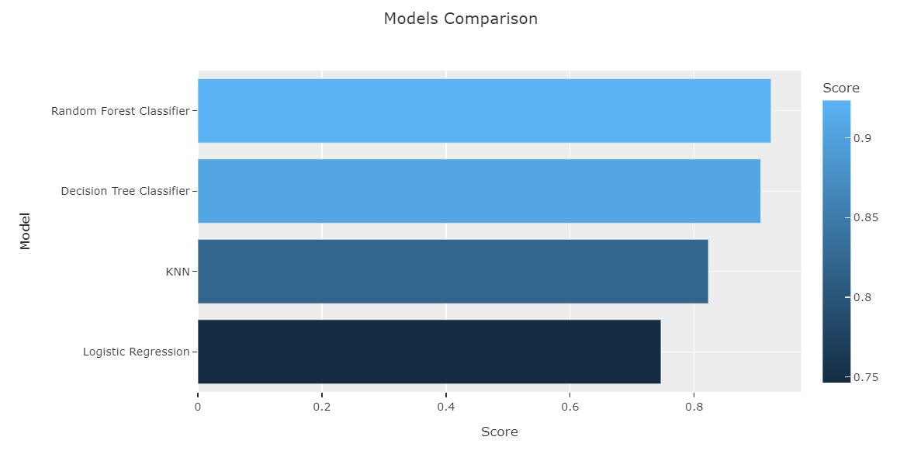
MODEL COMPARISON
Accuracy score
ROC/AUC score
ROC/AUC score
ROC = specificity/sensitivity
AUC = separability
7
Notes:
קטיה

Slide 21
MODEL EVALUATION
Accuracy score
= correct predictions / total number of data points
F1 score
= 2 * (precision * recall) / (precision + recall)
ROC/AUC score
ROC = specificity/sensitivity
AUC = separability
𝑃𝑟𝑒𝑐𝑖𝑠𝑖𝑜𝑛 = 𝑇𝑃/( 𝑇𝑃+𝐹𝑃)
𝑅𝑒𝑐𝑎𝑙𝑙 = 𝑇𝑃/(𝑇𝑃+𝐹𝑁)
specificity = TN/(TN+FN)
sensitivity = TP/(TP+FP)
7
Notes:
קטיה
a weighted average of the precision and recall, where an F1 score reaches its best value at 1 and worst score at 0.
𝑃𝑟𝑒𝑐𝑖𝑠𝑖𝑜𝑛 = 𝑇𝑃/( 𝑇𝑃+𝐹𝑃)
specificity = TN/(TN+FN)
sensitivity = TP/(TP+FP)
𝑅𝑒𝑐𝑎𝑙𝑙 = 𝑇𝑃/(𝑇𝑃+𝐹𝑁)

Slide 22
Our goal was to build a model that will be able to predict the probability of order cancellation based on the booking details. We built four different models, employing logit, decision tree classifier, random forest and KNN algorithms.
We conclude that the Random forest classification model performs the best for this type of task. It has highest accuracy score (the fraction of correct predictions is the highest) and ROC/AUC score (capability of model to distinguish between the classes)
We would require more data from more hotels and more countries in order to make more reliable predictions that could be sold like a booking evaluation tool.
CONCLUSION
9
Notes:
קטיה

Slide 23
CONCLUSION
By performing EDA we found that there is a high chance of cancellation when the customer had previous cancellations; additionally, being a repeated guest is a factor promoting a higher probability of ordering. As the dataset contained relatively few observations containing these features, additional data on these cases--repeated guests and cancellation history--would enhance the accuracy of the model.
Directions for future analysis: we propose to continue the research by adding more features to the data. For example, we could require data on hotel quality, availability of different meal preferences, stay prices, pool availability, hotel type, resort availability, attractions etc. This data can add significantly to the model precision and therefore increase the marketing value of the product.
9
Notes:
קטיה

Slide 24
CONCLUSION
Despite the fact that the model could be improved through enhancement of the dataset--by adding hotels, observations, features, etc.--our work still provides a predictive model with an accuracy of 93.8% accuracy--much better than the coin toss.
9
Notes:
קטיה

Slide 25

THANK YOU

